Slide 1

Stevens Institute of Technology
Engineering Bootcamp
ECOES (Exploring Career Options in Engineering and Science)
Darian Muresan, Ph.D. ECE
Stevens Teaching Professor in School of Systems and Enterprises

Slide 2
Agenda
Electrical and Computer Engineering / Computer Science
Stevens Institute of Technology Pre-College Programs
Real Case Product Demo -- 360 Interactive Spins
Product Development Cycles
Design and Development Tools
Hardware
Software
Algorithms
Hands on with Matlab
Machine and Deep Learning

Slide 3

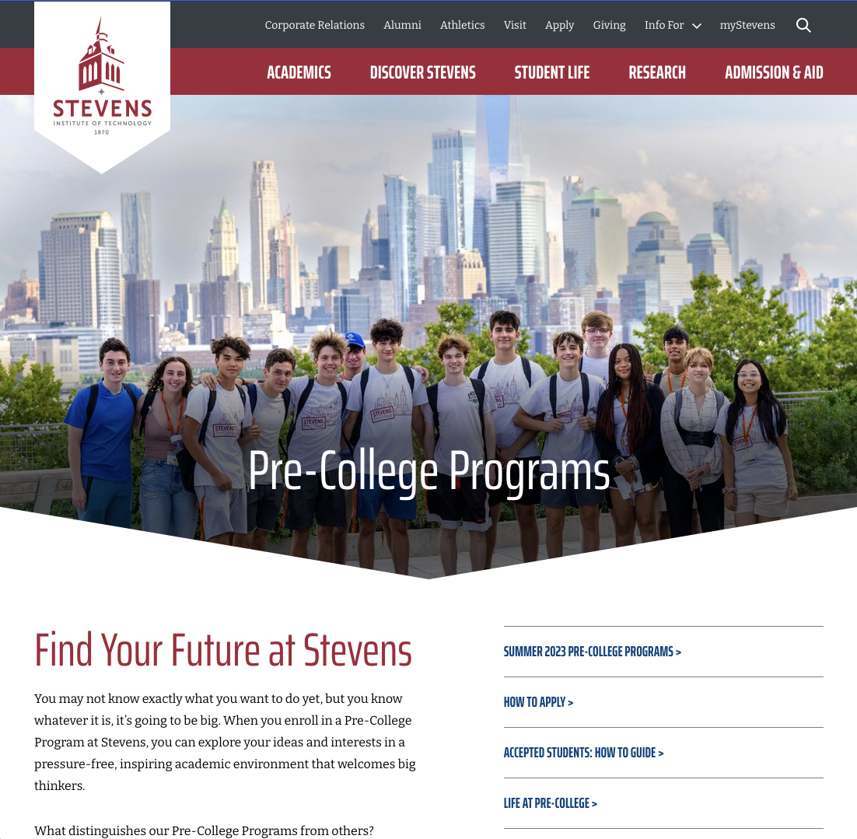
Pre-College Programs
Pre-College Programs
https://www.stevens.edu/admissions/pre-college-programs
Engineering Bootcamp
ECOES (Exploring Career Options in Engineering and Science)

Slide 4
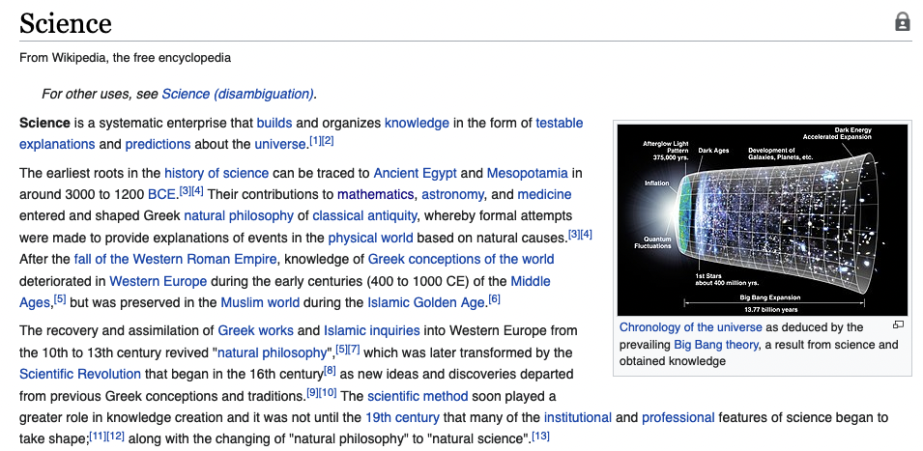
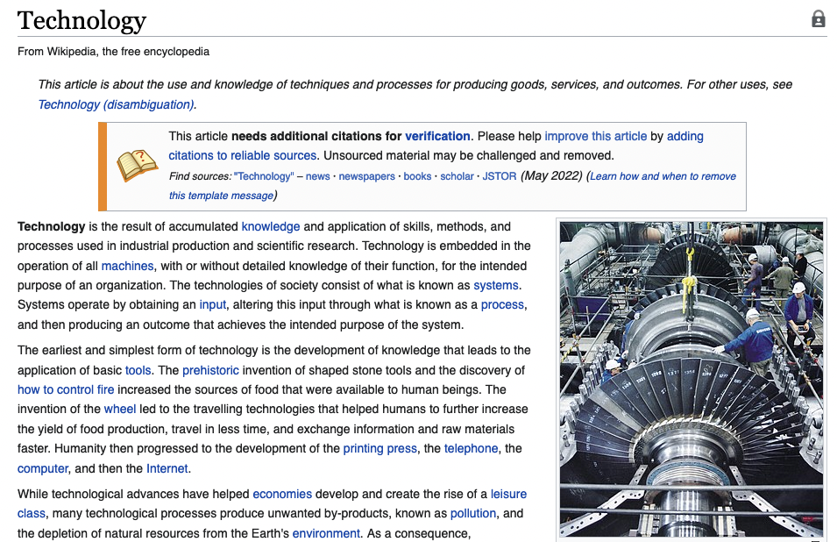
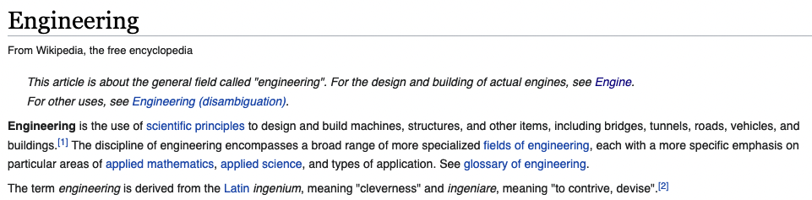
Stevens Academic Calendar and Academic Catalog
https://www.stevens.edu/directory/office-registrar/academic-calendar
https://www.stevens.edu/academics/academic-catalog

Slide 5
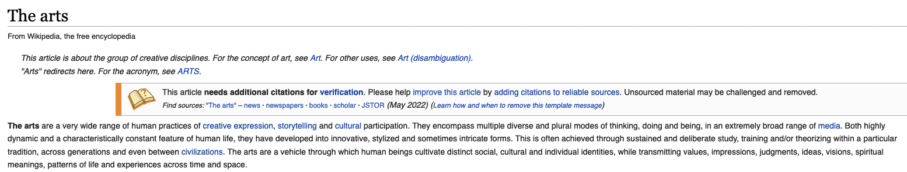
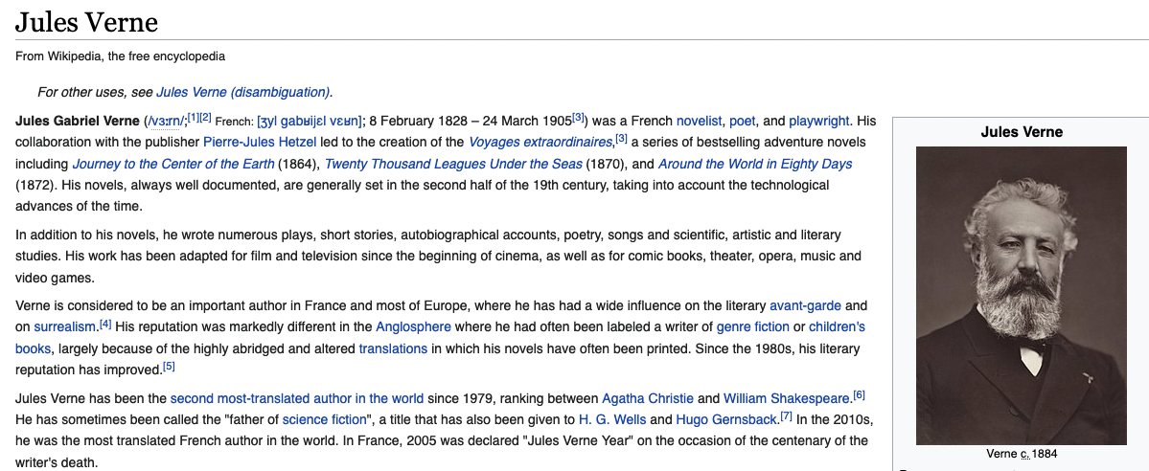
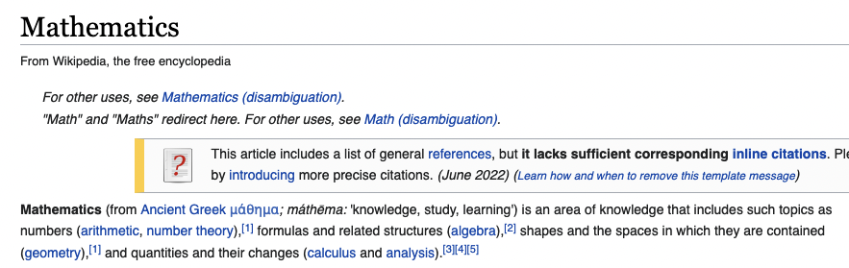
STEM / STEAM Engine / Engineer
STEM and STEAM
https://en.wikipedia.org/wiki/Science
https://en.wikipedia.org/wiki/Technology
https://en.wikipedia.org/wiki/Engineering
https://en.wikipedia.org/wiki/The_arts
https://en.wikipedia.org/wiki/Mathematics
Engine and Engineer
https://en.wikipedia.org/wiki/Engine
https://en.wikipedia.org/wiki/Engineer

Slide 6
Stevens Institute of Technology
1870: Stevens Institute of Technology opened.
https://en.wikipedia.org/wiki/Stevens_Institute_of_Technology
1884: The Department of Applied Electricity was established at Stevens.
1903: The name was changed to the Department of Electrical Engineering.
https://en.wikipedia.org/wiki/Electrical_engineering
1978: Computer Science (Electrical Engineering) became a concentration within the Engineering Program, in contrast to Computer Science (Mathematics) within the Science Program.
https://en.wikipedia.org/wiki/Computer_science
https://en.wikipedia.org/wiki/Science
1986: The Computer Engineering Program was accredited by ABET as a separate program.
https://en.wikipedia.org/wiki/Computer_engineering
Computer engineering blends computer science and electrical engineering to further advancements in digital electronics, networks, systems, applications, and services.
Integrating the latest innovations in artificial intelligence, electrical and computer engineers design and develop hardware and software to reach new levels of automation and productivity.

Slide 7
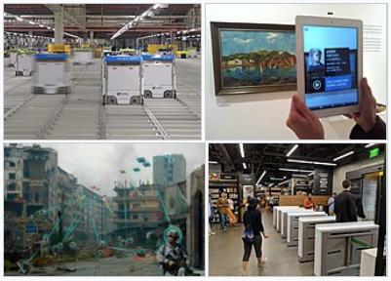
The Fourth industrial revolution (4.0)
The First (1760 and 1820) – from human power to steam and waterpower
The Second (Technological, from 1871 and 1914) – railroad and telegraph networks
The Third (Digital, after WWII to 2000) – extensive use of computer and communication technologies
The Fourth Industrial Revolution (Industry 4.0) is:
the ongoing automation of traditional manufacturing and industrial practices, integrating large-scale machine-to-machine communication
Integration with the internet of things (as well as cyber-physical system and digital twin) for increased automation
improved communication and self-monitoring
production of smart machines that can analyze and diagnose issues without the need for human intervention.

Slide 8
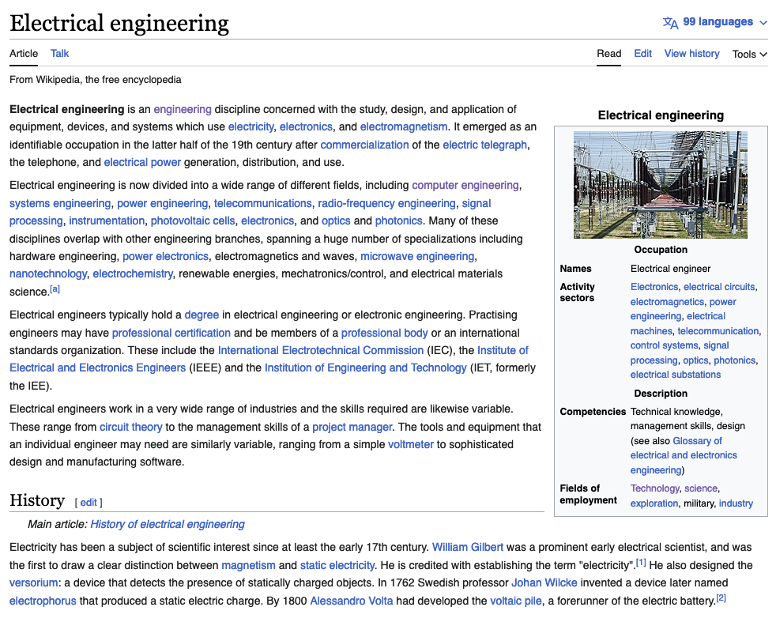
What is Electrical Engineering?
https://en.wikipedia.org/wiki/Electrical_engineering
Electrical engineering is divided into a wide range of different fields, including computer engineering, systems engineering, power engineering, telecommunications, radio-frequency engineering, signal processing, instrumentation, photovoltaic cells, electronics, and optics and photonics.
Many of these disciplines overlap with other engineering branches, spanning a huge number of specializations including hardware engineering, power electronics, electromagnetics and waves, microwave engineering, nanotechnology, electrochemistry, renewable energies, mechatronics/control, and electrical materials science.

Slide 9
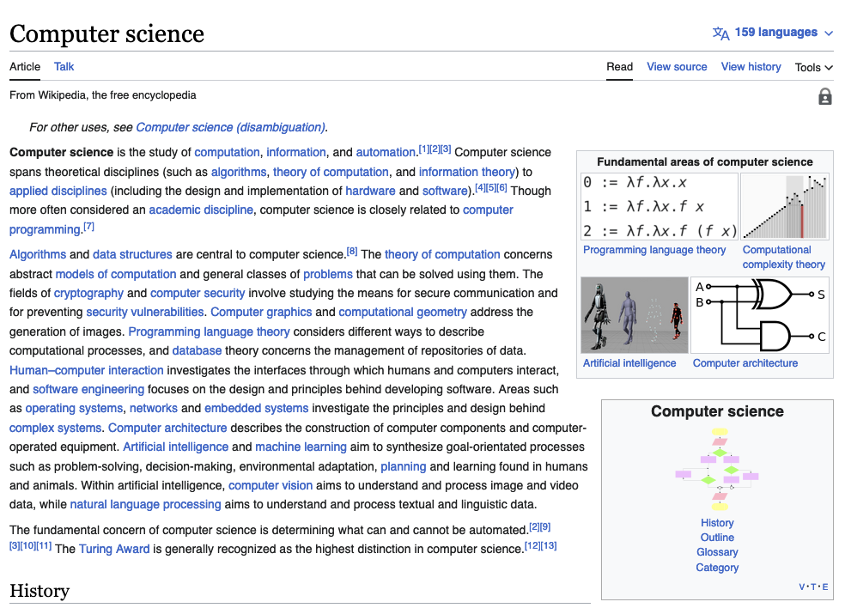
What is Computer science
https://en.wikipedia.org/wiki/Computer_science
Computer science is the study of computation, information, and automation.^{[1][2][3]} Computer science spans theoretical disciplines (such as algorithms, theory of computation, and information theory) to applied disciplines (including the design and implementation of hardware and software).^{[4][5][6]} Though more often considered an academic discipline, computer science is closely related to computer programming.^{[7]}

Slide 10
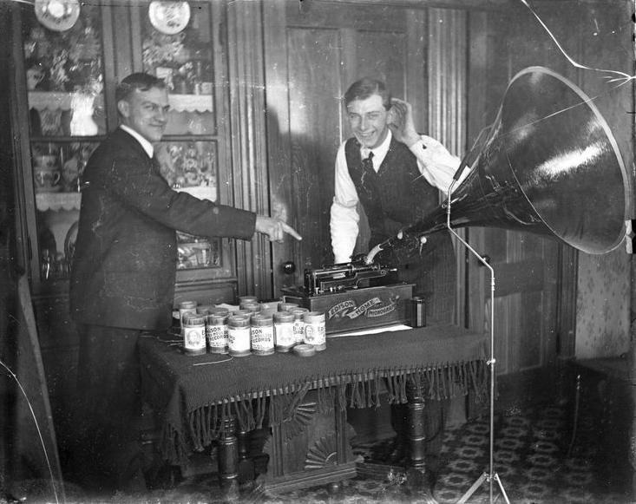
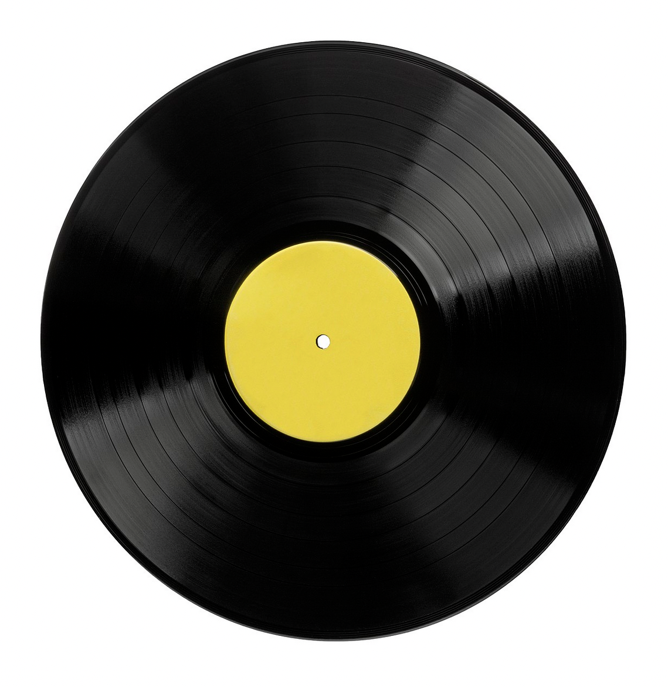
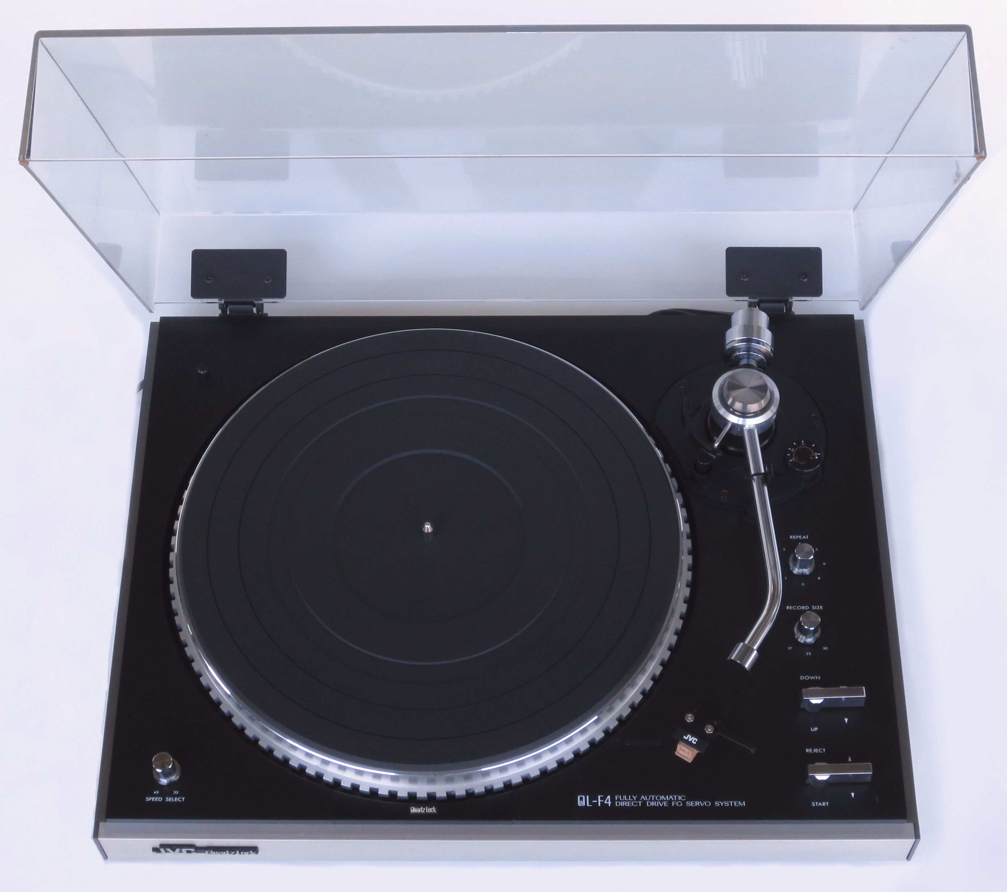
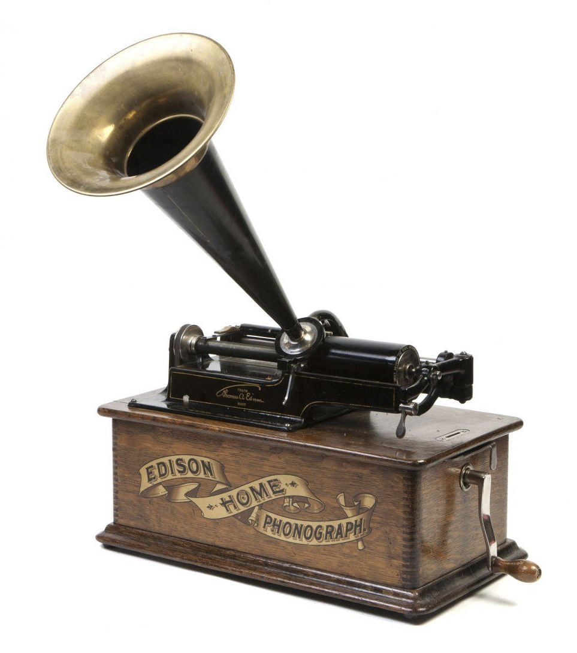
Analog vs digital

Slide 11
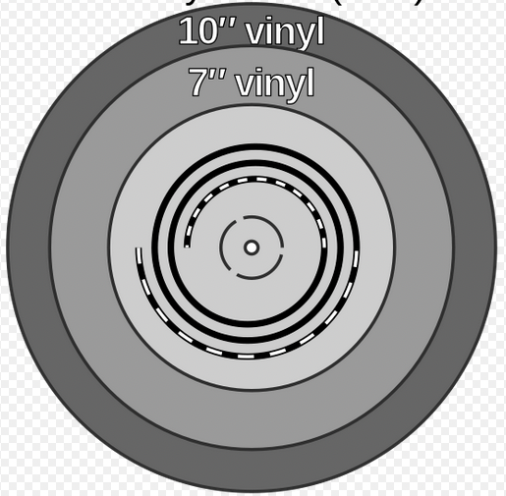
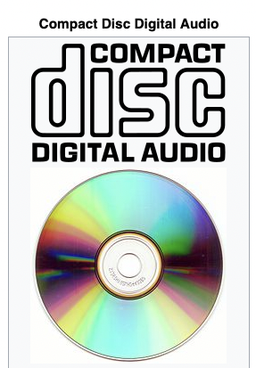
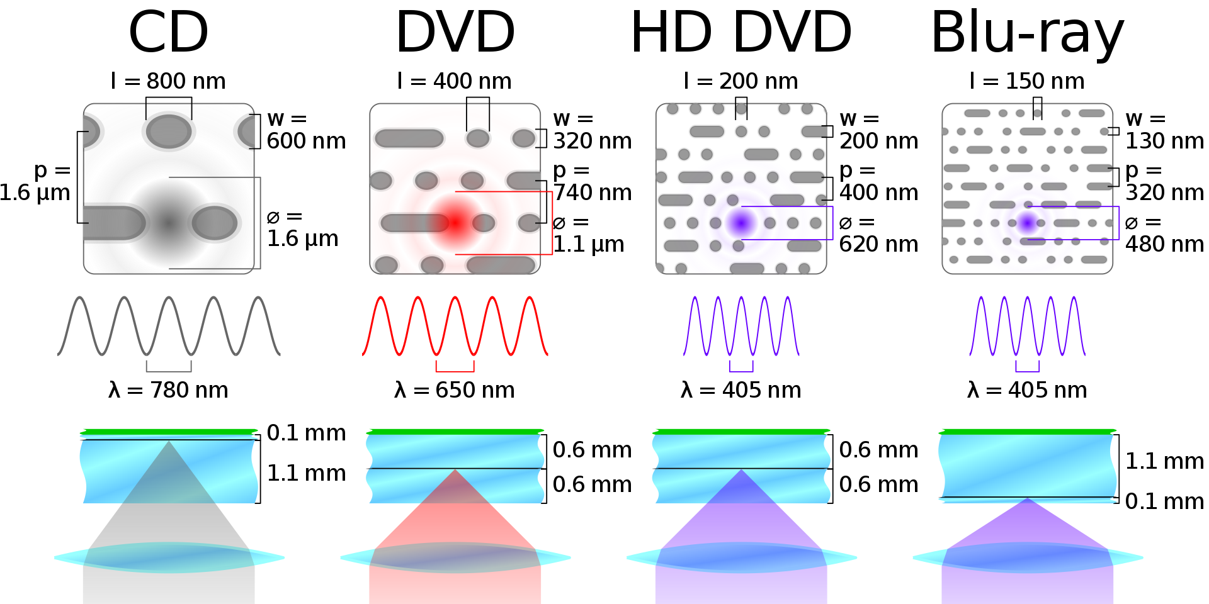
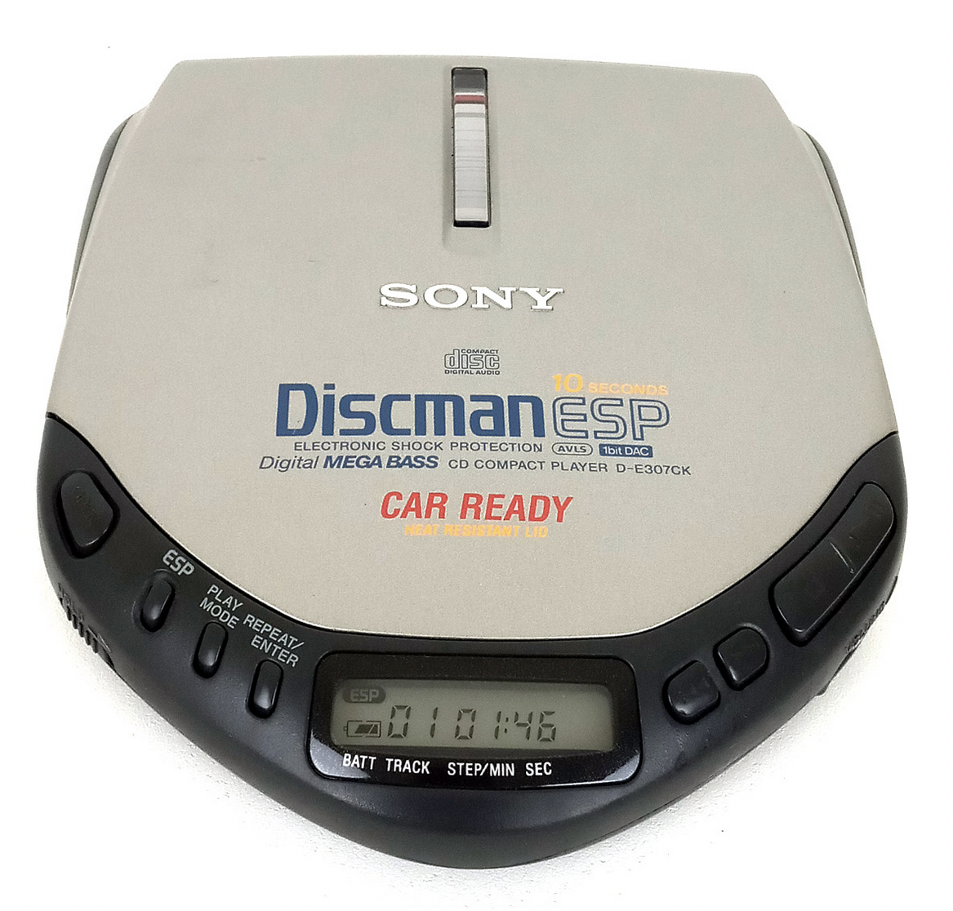
Analog vs digital

Slide 12
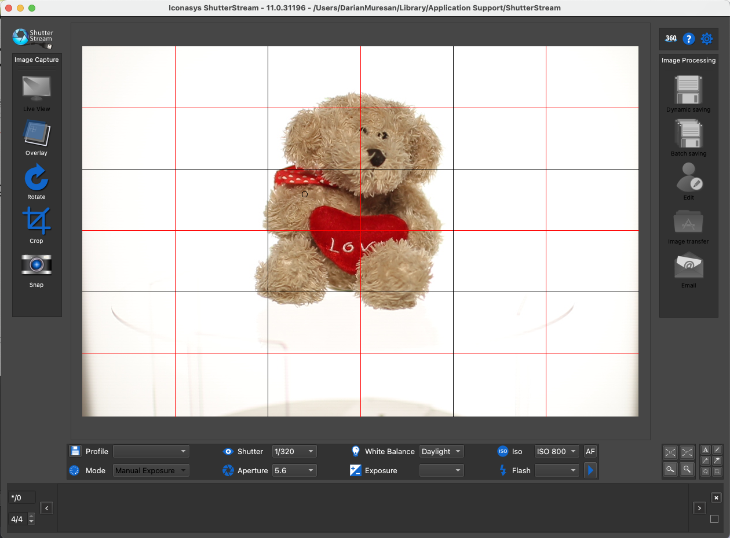
360 Product Photography Demo
eCommerce Image Editing and Acquisition tools
Photoshop / Lightroom with connected hardware

Slide 13
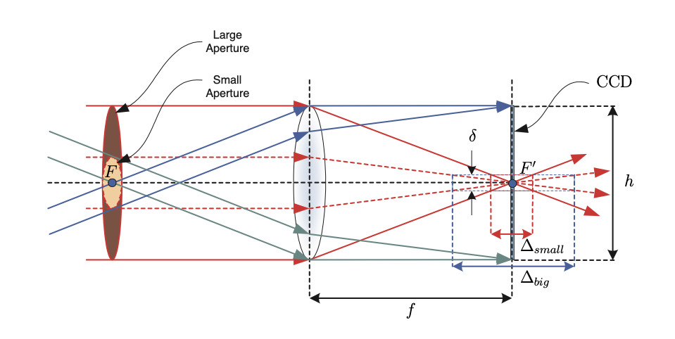
Aperture and depth of field

Slide 14

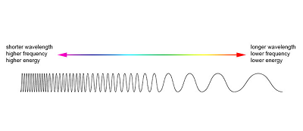
360 Product Photography Demo Darian Muresan, Ph.D.

Slide 15


F/3.5
F/36

Slide 16
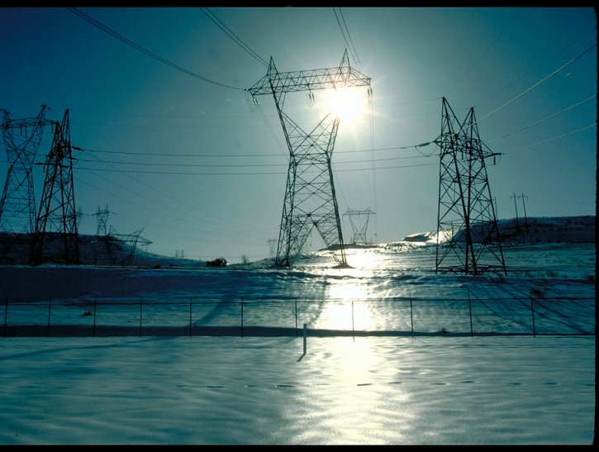
Alternating and Direct Current in power lines
Edison developed direct current
Direct current is not easily converted to higher or lower voltages.
Tesla believed that alternating current (or AC) was the solution
Easier to convert using transformers
The Chicago World’s Fair -- also known as the World’s Columbian Exposition -- took place in 1893, at the height of the Current War.
General Electric bid to electrify the fair using Edison’s direct current for $554,000, but lost to George Westinghouse, who said he could power the fair for only $399,000 using Tesla’s alternating current.
That same year, the Niagara Falls Power Company decided to award Westinghouse -- who had licensed Tesla’s polyphase AC induction motor patent -- the contract to generate power from Niagara Falls.
Methods are now available for converting direct current to higher and lower voltages. Since direct current is more stable, companies are finding ways of using high voltage direct current (HVDC) to transport electricity long distances with less electricity loss.

Slide 17
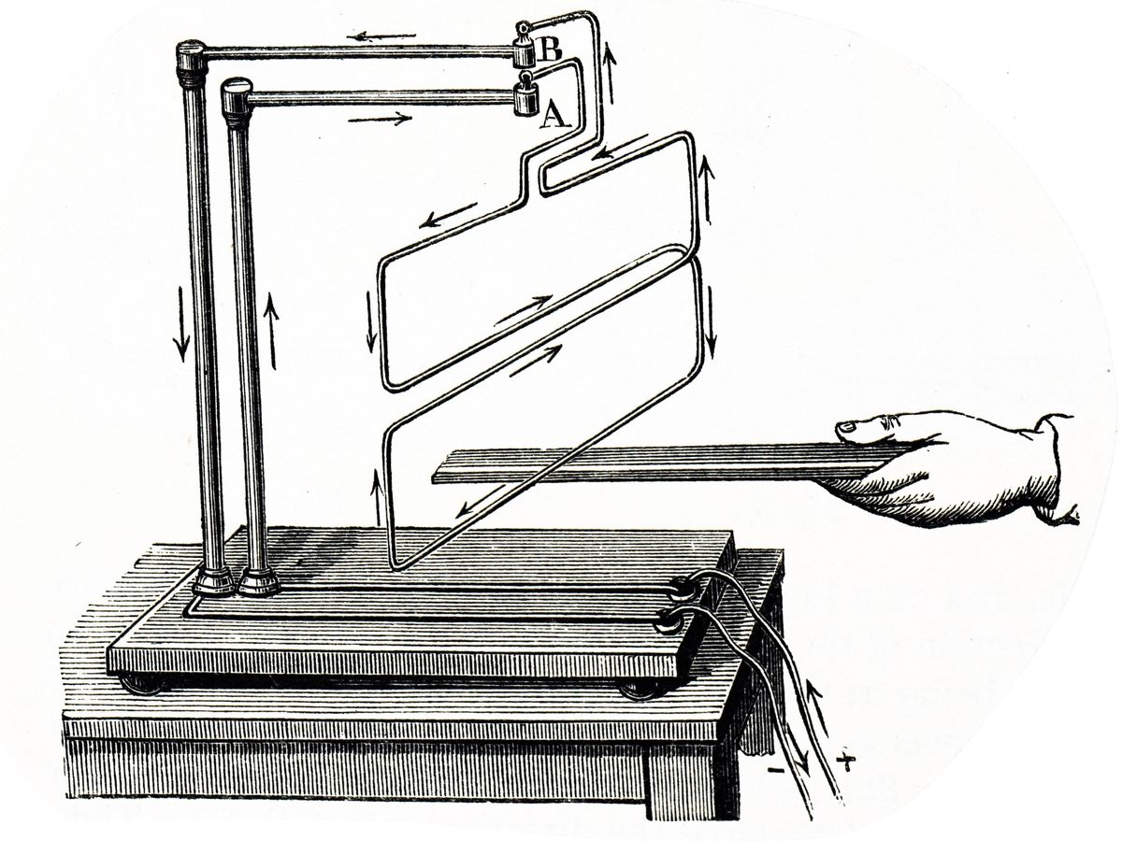
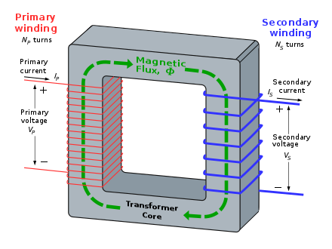
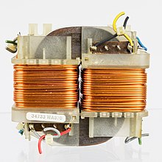
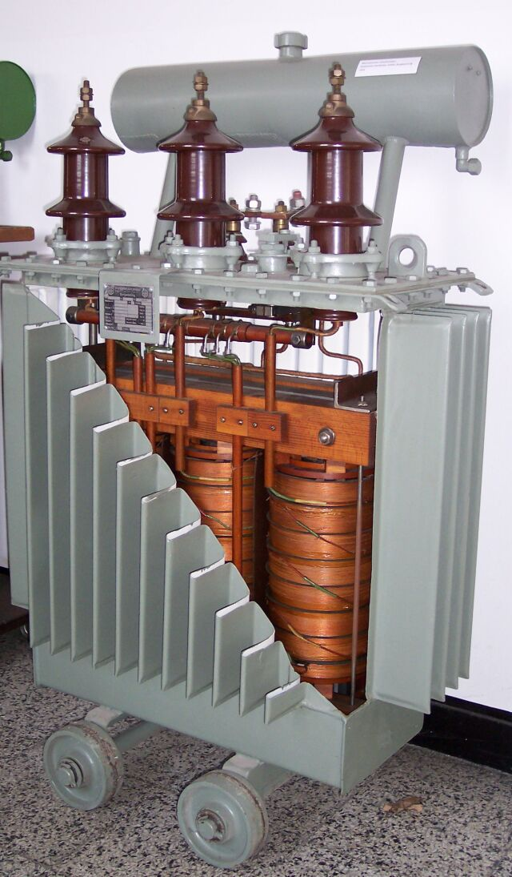
AC Transformers
According to Faraday's law, since the same magnetic flux passes through both the primary and secondary windings in an ideal transformer, a voltage is induced in each winding proportional to its number of windings.
High core magnetic permeability

Slide 18
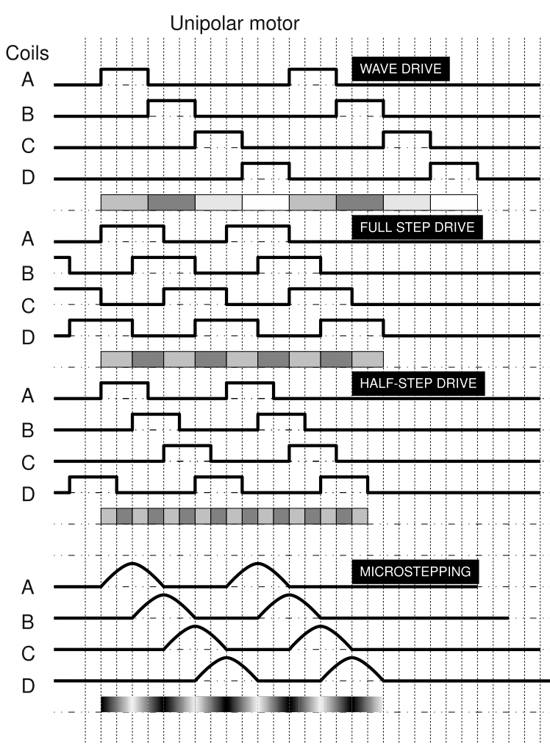
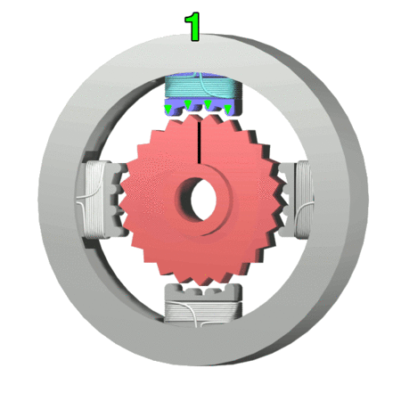
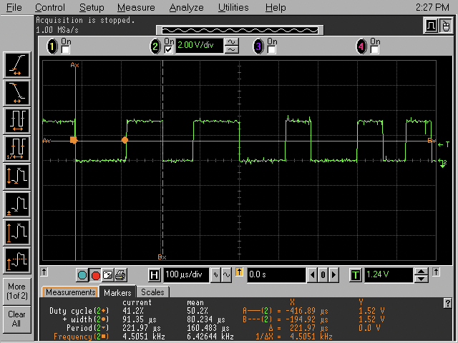
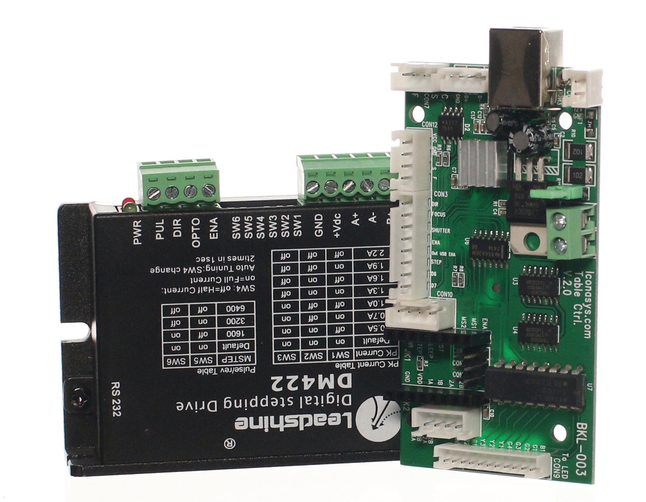
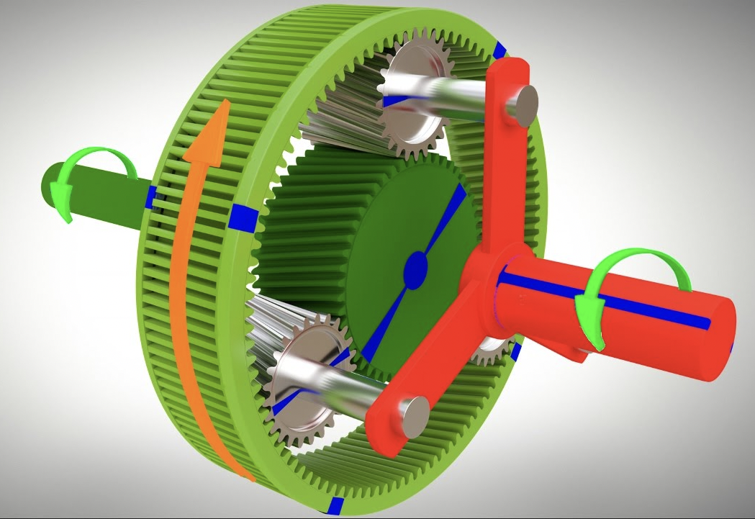
Turntable and hardware Controller
Stepper Motor
Gearbox
Planetary
Blet driven
Worm gearbox
PC Interface
Arduino
Raspberry PI
Custom
Software Interface

Slide 19
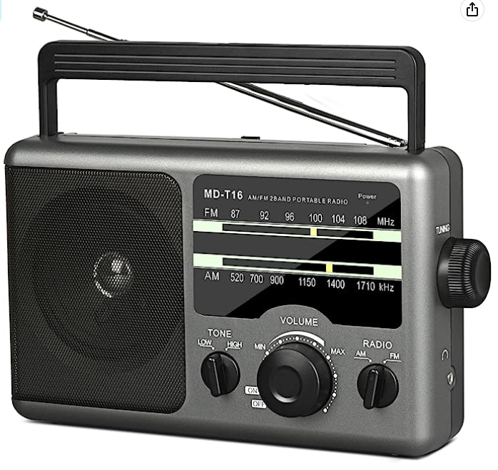
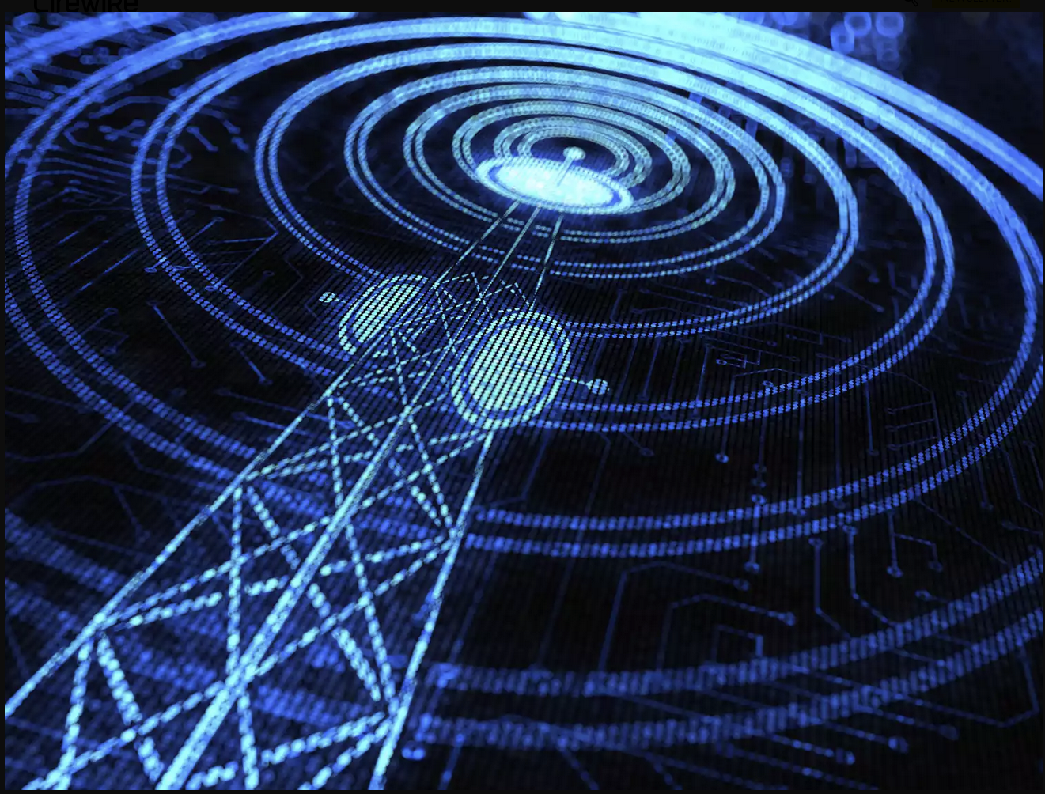
Data Communication AM/FM Radio and digital encoding

Slide 20
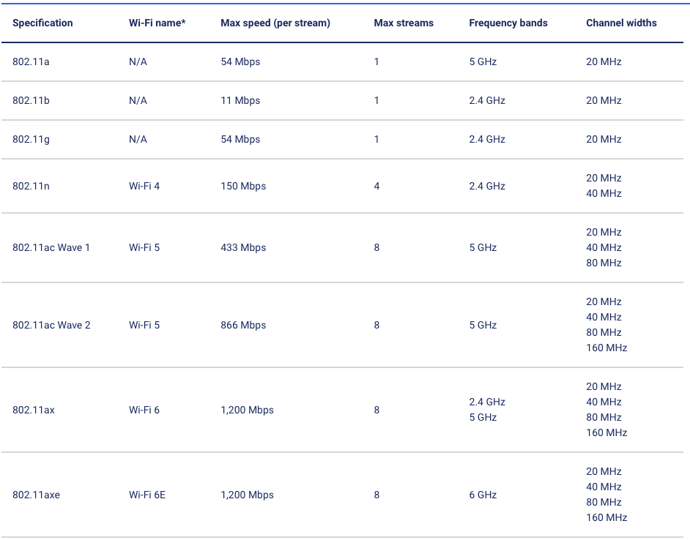
Why do I care? Because of wi-fi
Wi-Fi uses radio waves with a faster frequency than AM and FM radio.
AM radio is measured in kilohertz and FM radio in megahertz
Wi-Fi is measured in gigahertz. This measurement is why you see Wi-Fi connections labeled as 2.4 GHz and 5 GHz—which are a generalization of frequency ranges.

Slide 21
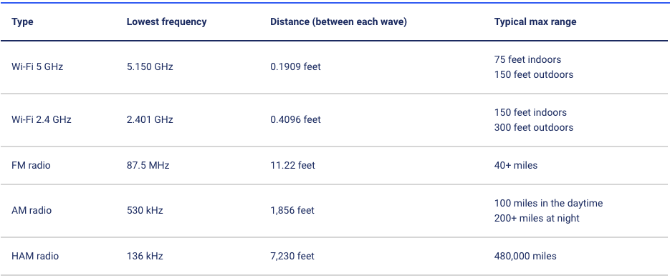
Why can’t I have wi-fi like radio?

Slide 22
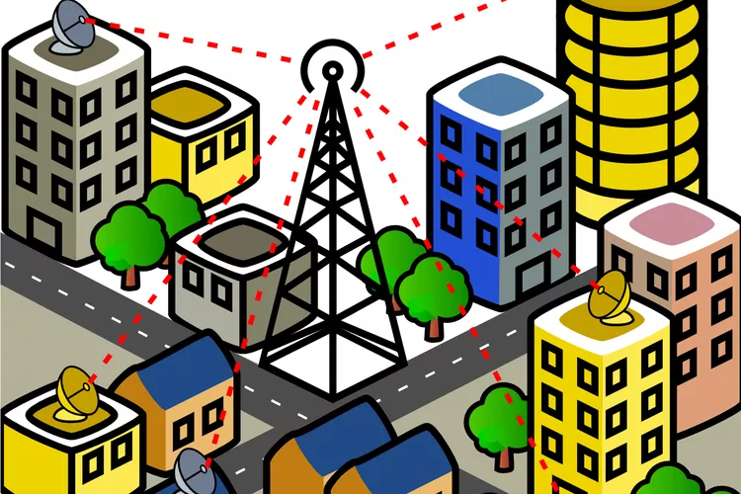
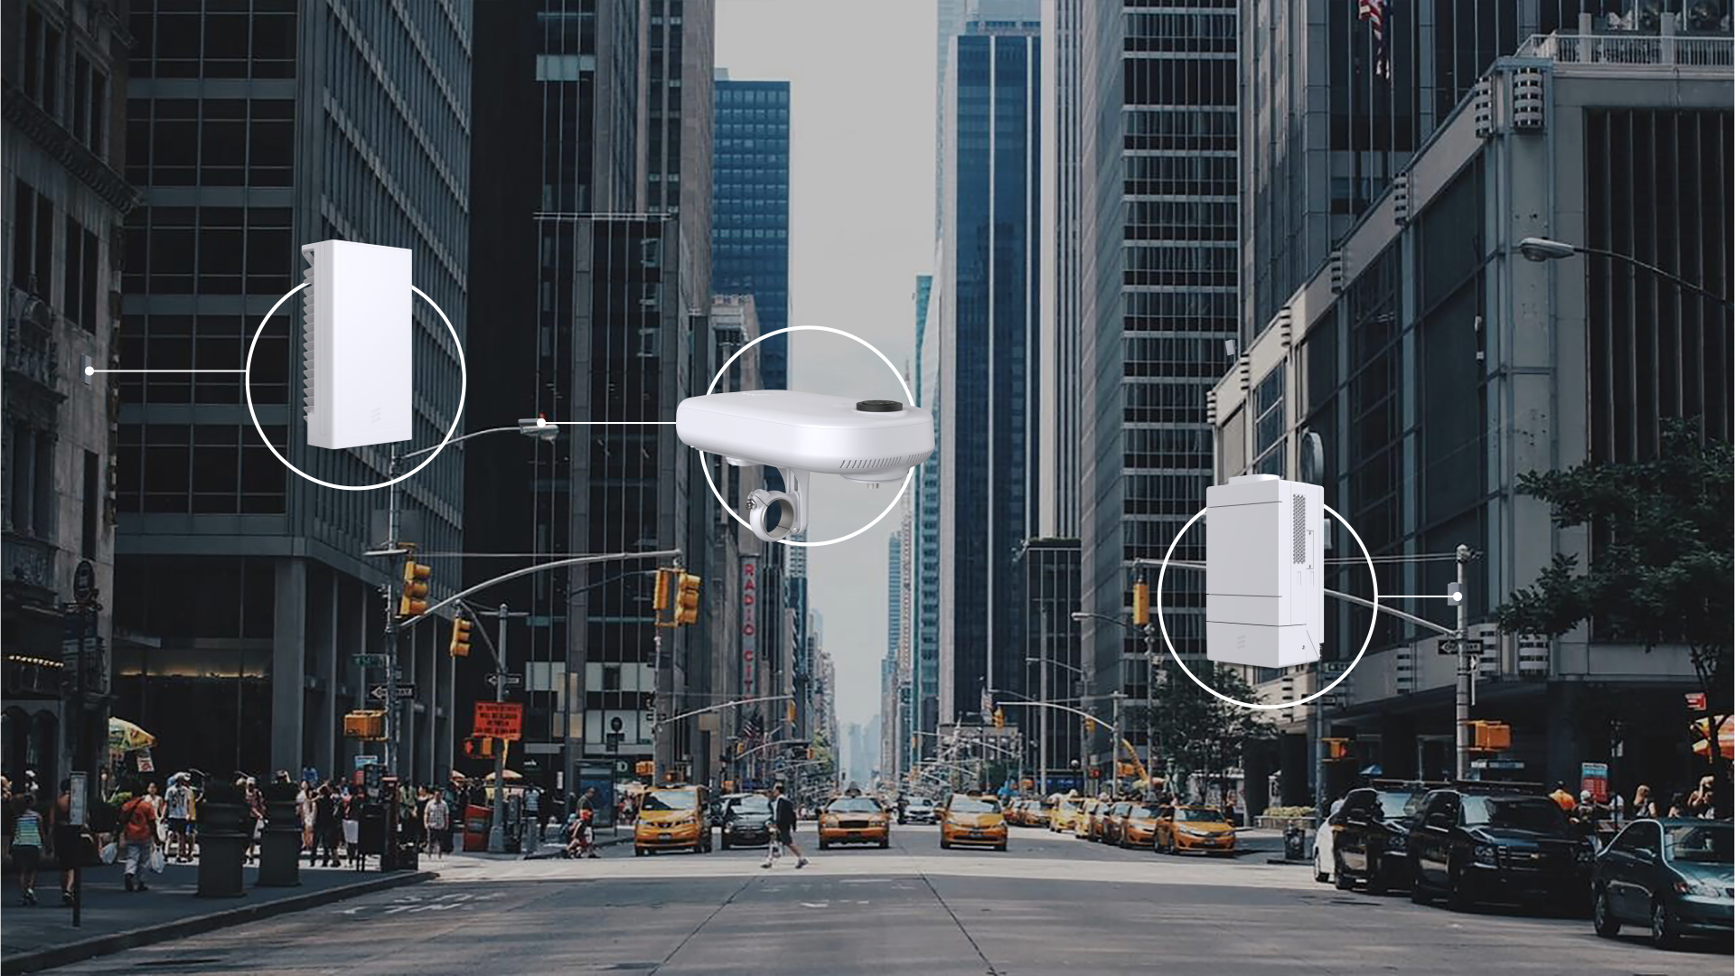
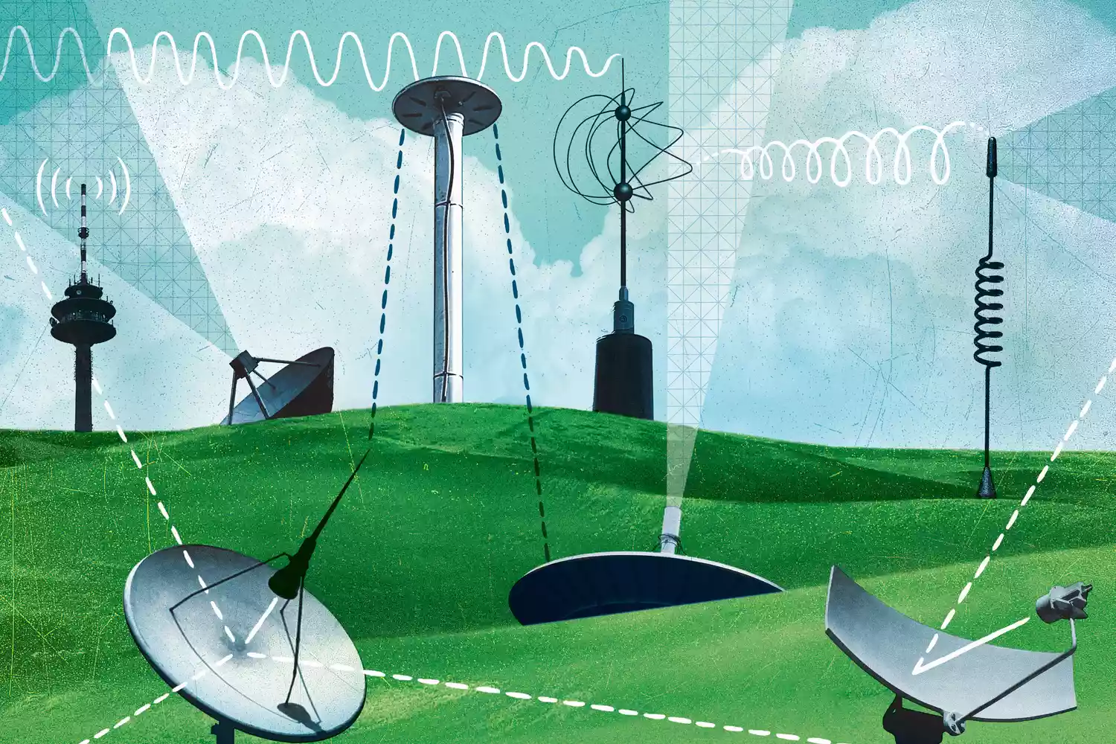
5G Wi-fi

Slide 23
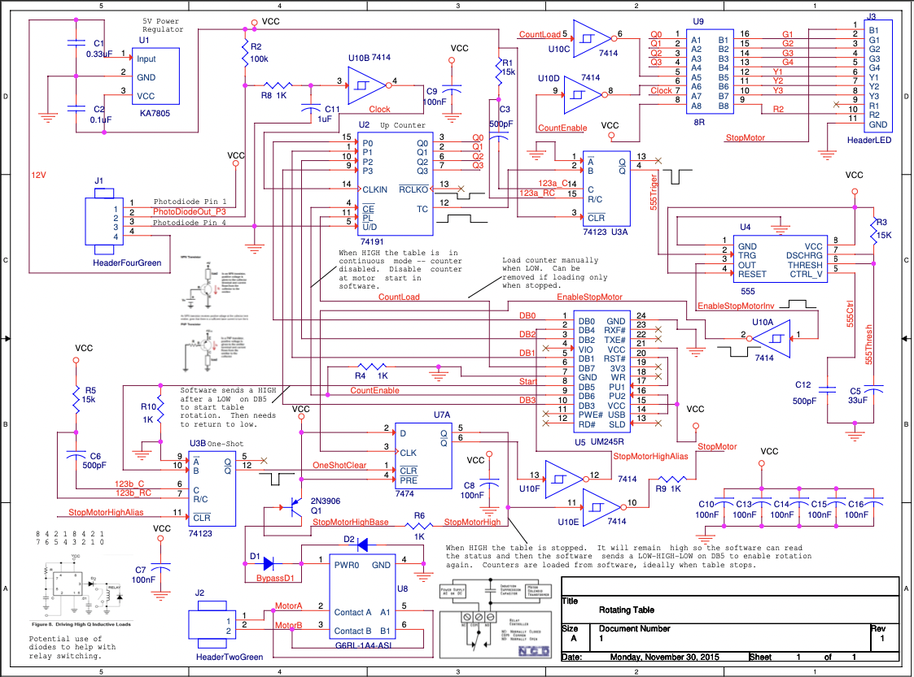
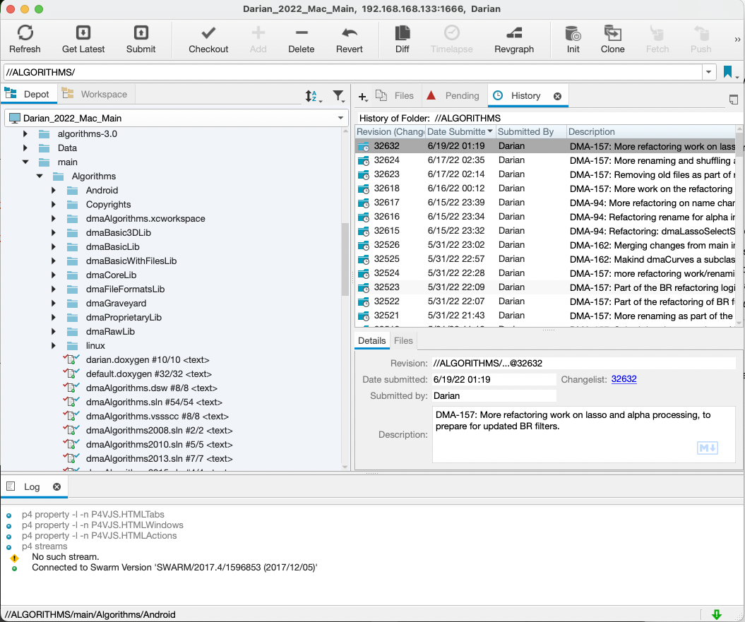
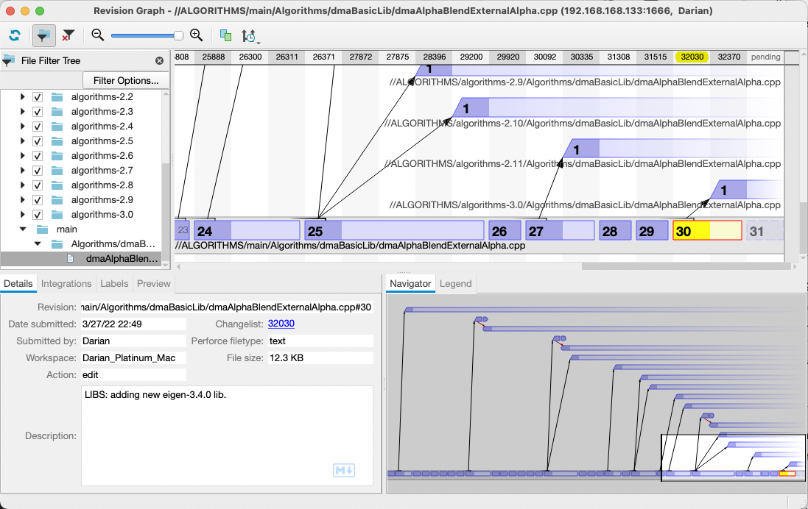
Agile Software Development Processes
Documentation
Doxygen (from source code) https://www.doxygen.nl/index.html
http://pictomic.com/test_dmaAlgorithms/main/Doxygen/html/
LaTeX (design logic, UML and block diagrams)
http://pictomic.com/test_dmaAlgorithms/main/Doxygen/html/manualCompleteArchitecture.pdf
Confluence https://www.atlassian.com/
Wiki pages
Version code control https://en.wikipedia.org/wiki/Version_control
GIT
Perforce
Many others
Code Review https://www.guru99.com/code-review-tools.html
GitHub
Swarm for Perforce
Many others
Bug Tracking https://en.wikipedia.org/wiki/Bug_tracking_system
Bugzilla
Atlassian JIRA
Agile boards

Slide 24
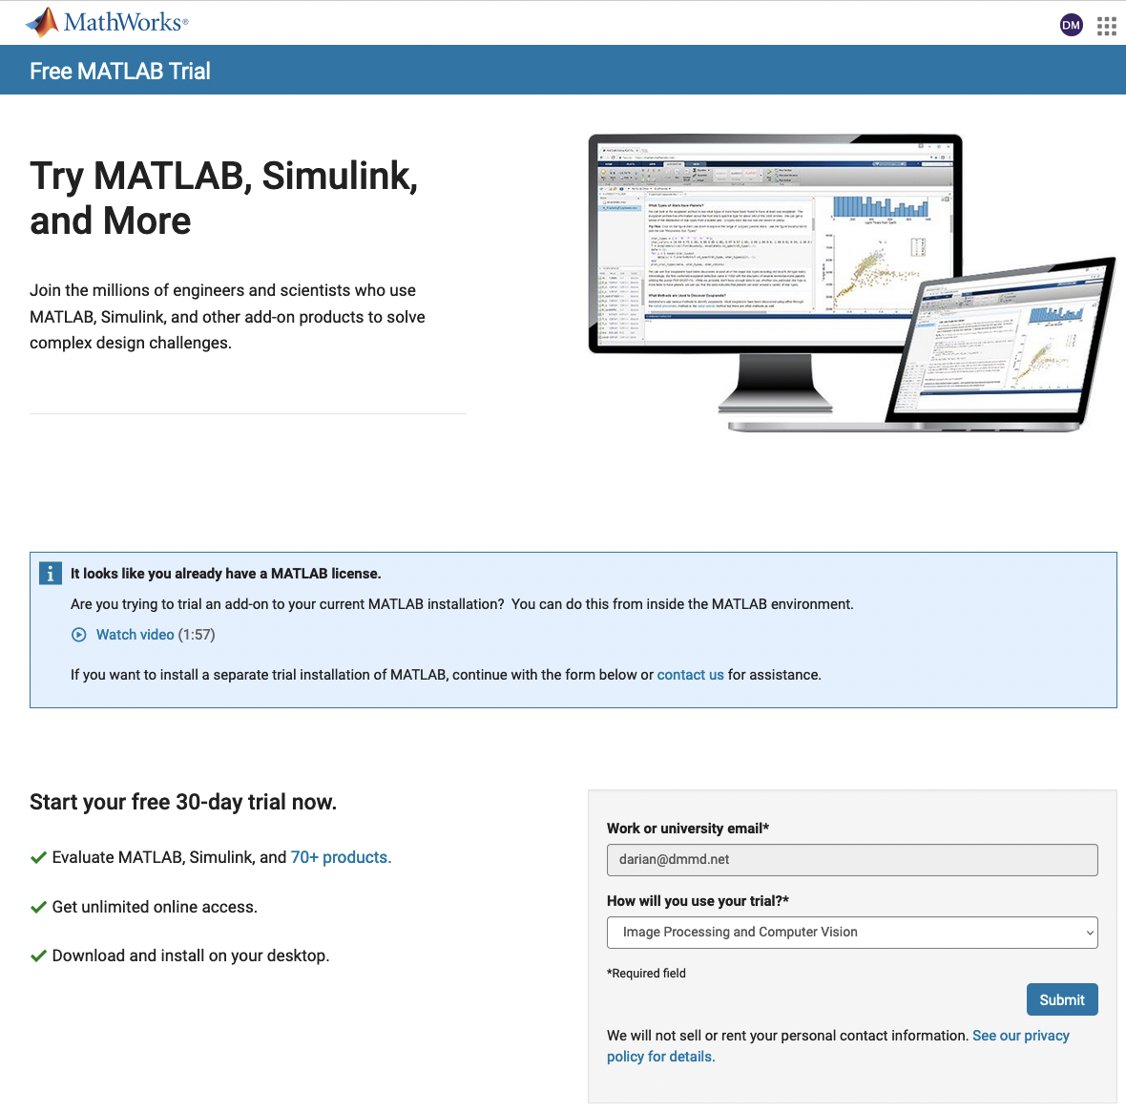
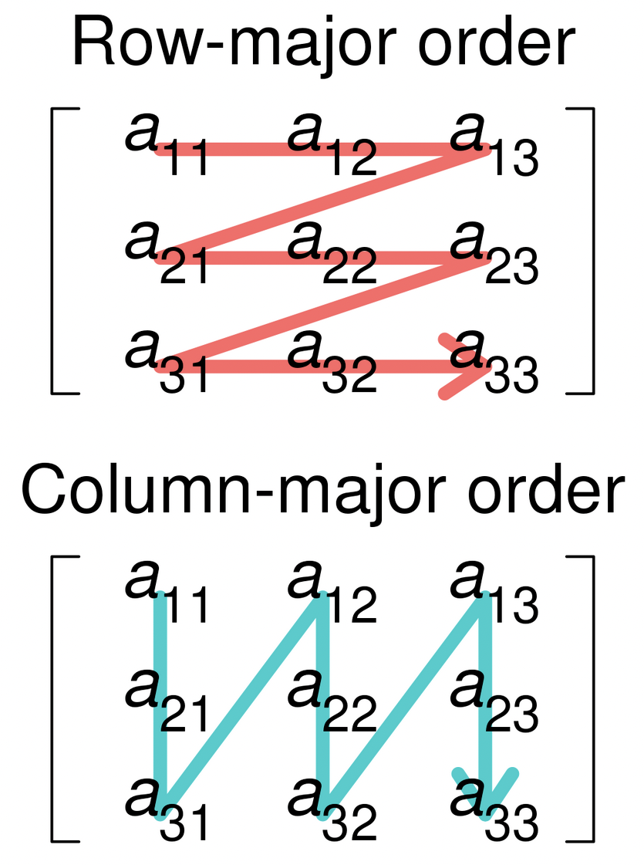
Matlab Online
https://www.mathworks.com/campaigns/products/trials.html
Matlab is column major
1-Indexing

Slide 25

Implement a few image editing functions in Matlab
Blur – with average filter
Unsharp masking
Edge detection with thresholding
Image Crop

Slide 26
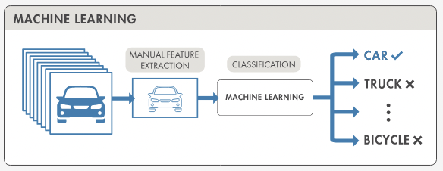
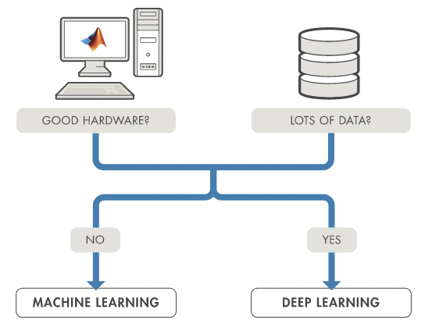
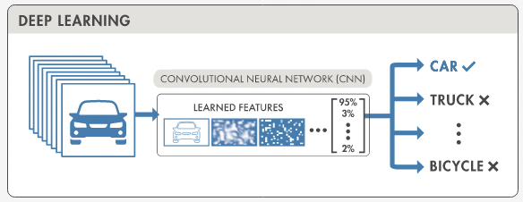
Machine and deep Learning

Slide 27
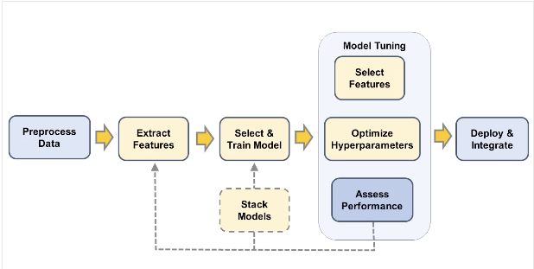
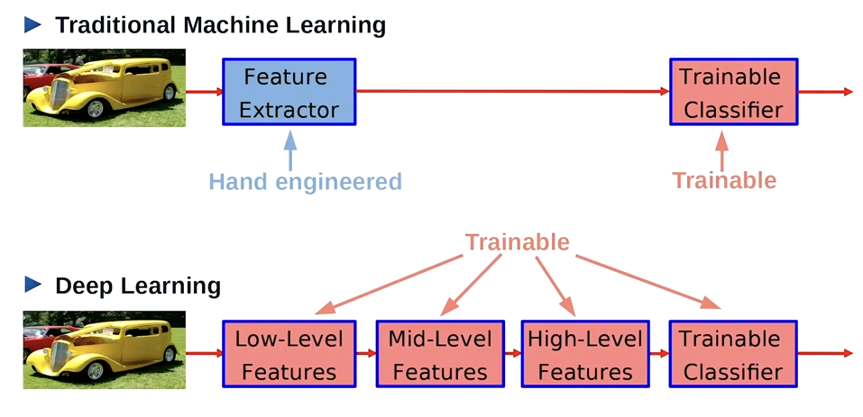
Machine Learning
Extract Features
Train Model
Clustering
Table lookups
Least Squares

Slide 28
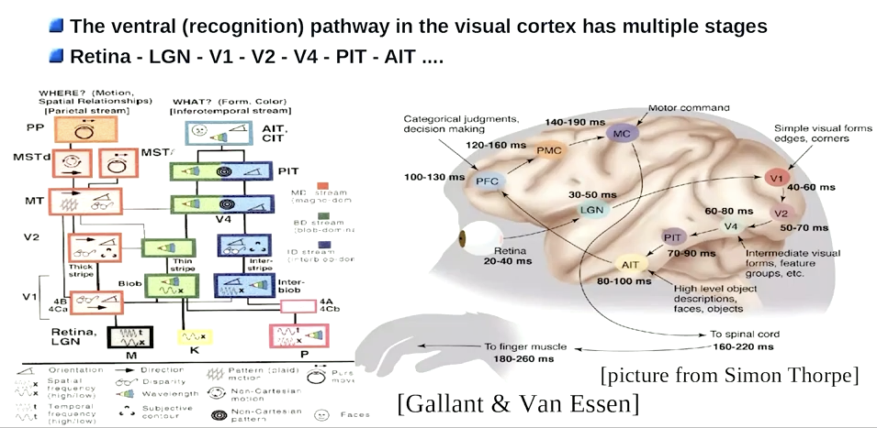
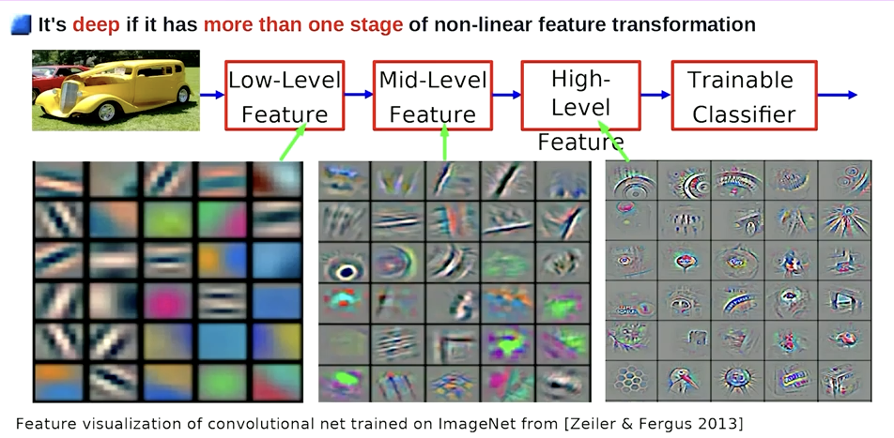

Deep Learning

Slide 29


Deep learning
Requires training data
Garbage in, garbage out
Can be easily biased
Training strategies
Network architectures

Slide 30




Deep learning

Slide 31




Transfer Learning

Slide 32




Deep learning with matlab

Slide 33
Deep learning demoes
Object recognition in Matlab
Background removal

Slide 34


Backup: data ordering

Slide 35



Backup: data ordering and parallelization

Slide 36


Backup: demosaicing and camera design

